Slide 1
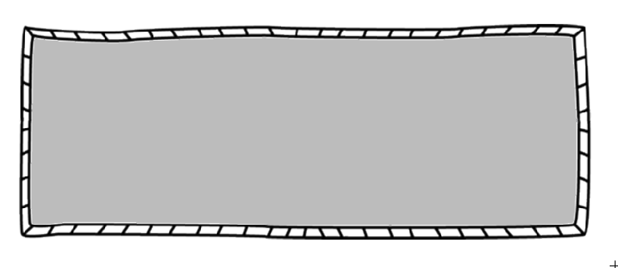
Personal Electronic Devices are NOT allowed during class unless directed by the teacher.
msmorgansmath.weebly.com
The class website will be your go-to spot for homework, important announcements, extra help resources, printable papers, and much more.
Register to receive text messages and/or
e-mail messages with reminders, homework assignments, and other class information.
When you sign up, remind101 will not share your phone number/email address so everything stays private!
Text to following class code to 81010
Algebra 1: @922d63
Honors Geometry: @922d630
Geometry Support: @922d6306
Supply List
Pencils
Erasers
Loose leaf paper
Chattooga High
Ms. Morgan’s Math
706-857-2402
Liza Morgan lmorgan@chattooga..k12.ga.us
Assignments
Extra Help
If a student is having trouble they should speak with the teacher as soon as possible. The teacher will work with the student to schedule time for extra help.
Students must show all necessary steps and explain your thinking process used to arrive at the correct answer on ALL work. Failure to do so may result in loss of credit for the problem. All assignments need to be completed in pencil. Cheating will result in a grade of zero.
Test Corrections
For each unit test you will be allowed to retake the test within 3 days of original test. Arrangments must be made before school (7am).

Slide 2
Ms. Morgan’s Math Course Guide
2015-2016
I have read and understand the course guide.
_________________________________
Student Name
_________________________________
Student Signature
_____________
Date
_________________________________
Parent/Guardian Name
_________________________________
Parent/Guardian Signature
_____________
Date

